Slide 1



Raised Expectations
Manage your
our repository

Slide 2

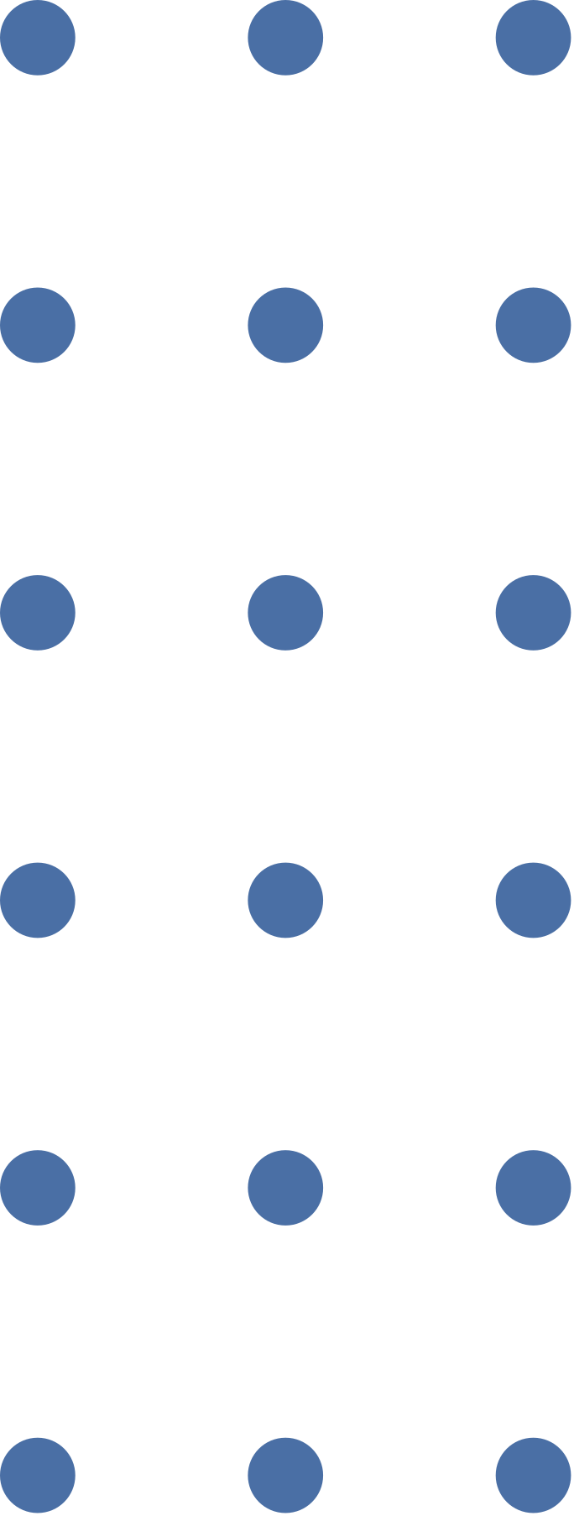
RESEARCH FRAMING
The social dynamic examined was interpersonal communication in situations of reduced biomechanical stability, which is both societally and scientifically significant.
Most previous research on aspects of vocal production have been in stable lab environments, often in seated positions (Zsiga, 2014). However, this doesn’t consider that humans are often not stationary.
Movement, such as walking, can have an impact on aspects of the voice, such as pitch and rhythm (e.g., Anikin, 2023; Chiu et al., 2026).
When the body is moving, several biological mechanisms are employed in order to keep the body upright, with the body’s centre of gravity constantly shifting as the body moves (Tesio & Rota, 2019).

Slide 3

WHY PITCH AND EYEBROWS?
In English, pitch plays important prosodic signalling functions at both the word level (e.g. stress) and the sentence level (e.g. intonation and information structure).
There is evidence that eyebrow raises may serve a similar prosodic function in the visual domain, marking prominence and conveying communicative functions such as turn-taking (Cavé, Guaïtella & Santi, 2002).
Perception research suggests that when pitch information provides conflicting cues to prominence, people will use eyebrow information to infer the location of prominence (Krahmer et al., 2002).
Still unclear exactly how well coordinated pitch and eyebrow movements are, and how eyebrow movements may coordinate between interlocutors.

Slide 4

RESEARCH QUESTIONS
Q1: What is the relationship between pitch and eyebrow movements?
Q1.2: How does this relationship change, if at all, when the bodily center of gravity is perturbed?
RQ2: What is the nature of the eyebrow synchrony between the clue giver and guesser?
RQ2.2: How is this changed, if at all, when the bodily centre of gravity is perturbed?

Slide 5
HYPOTHESES
Raised eyebrows are associated with higher pitch in the clue-giver when they are standing on the ground.
Under increased postural stability demands (the clue-giver is standing on the wobble board), the co-variation between eyebrow movement and pitch dynamics is distorted.
Higher mutual information in eyebrow movements between the clue giver and the guesser is associated with faster guessing times (higher task performance).

Slide 6
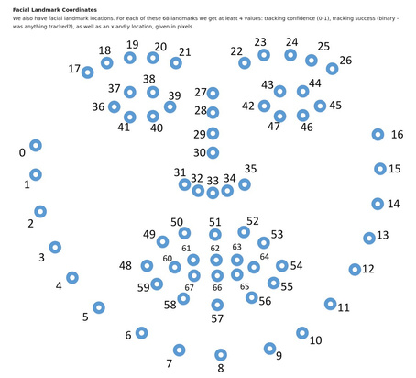


METHODOLOGY
BALANCE DATASET
(LI ET AL., 2026)
Two dyads (f=3, m=1, mean age= 19.5)
One target word (‘Birthday’)
Eyebrow - OpenFace data extracted from video data. Took the X and Y coordinates for the eyebrows (points 17-26) and the tip of the nose (point 33). Relative positions of points 17-26 as well as y-axis displacement of eyebrow centre of mass from tip of nose. Both guesser and cluegiver
Pitch - Extracting fundamental frequency (f0) for audio files using the parselmouth library [@jadoul_etal18]. We used the Diarization data to split the f0 by speaker. This was the manually checked for the examples (for a larger analysis pipeline, we plan to use a multi speaker separation as this would allow potential extraction of pitch information when two speakers are speaking simultaneously. Cluegiver only

Slide 7
METHODOLOGY
ANALYSIS
Hypothesis 1: Linear and non-linear interaction measures: correlation, covariance, mutual information, time-delayed mutual information (JIDT + pySPI); WMS
Hypothesis 2: Cross-Recurrence Quantification Analysis with phase-space reconstruction to analyse coupling between eyebrow movement and pitch dynamics on an intrapersonal level
Hypothesis 3: Multivariate mutual information applied to brow positions (JIDT)

Slide 8
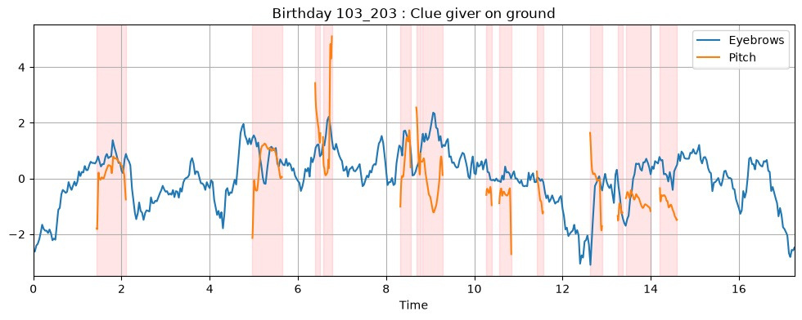
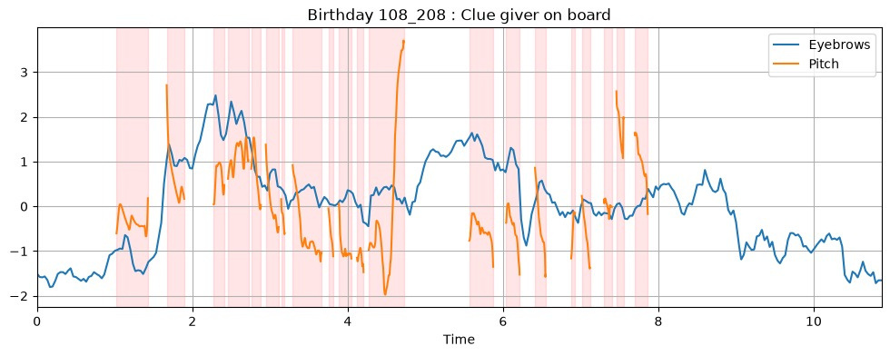
WINDOWED MULTISCALE SYNCHRONY

Slide 9
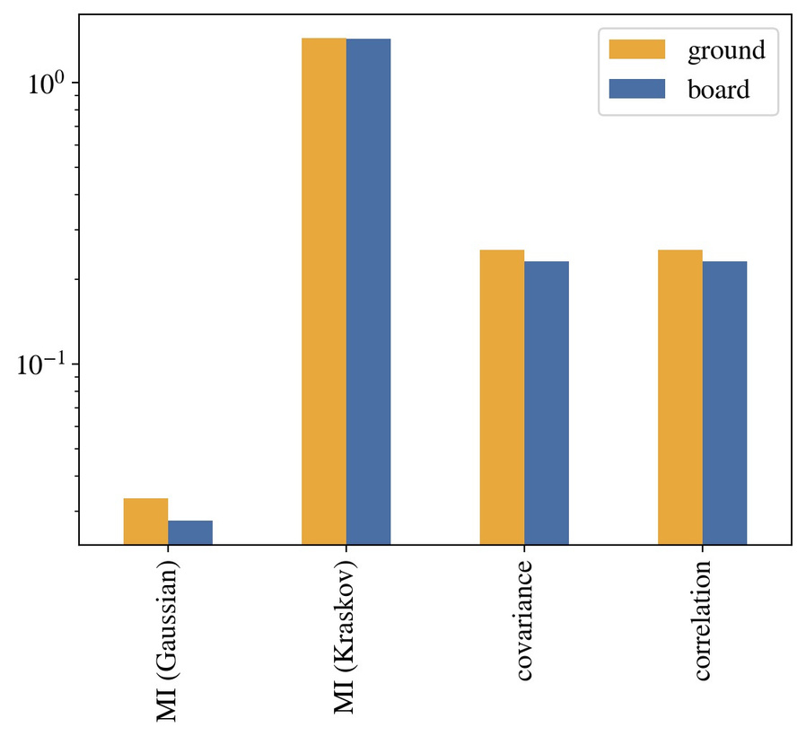
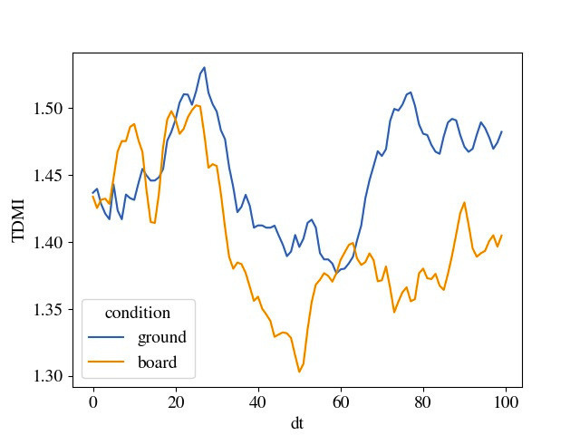
TIME-DELAYED MUTUAL INFORMATION

Slide 10
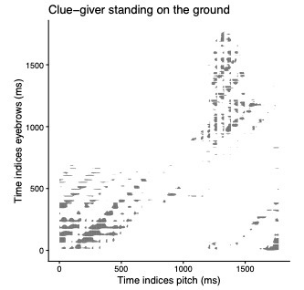
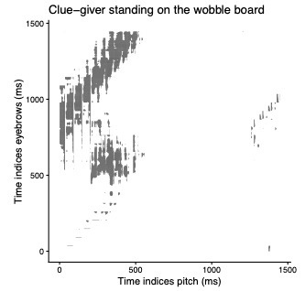
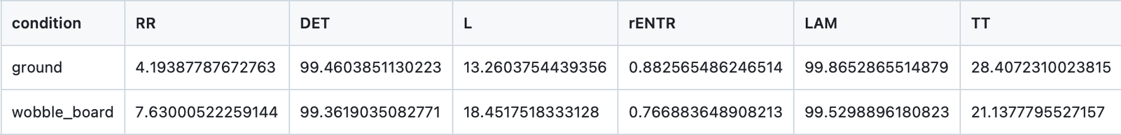
CROSS-RECURRENCE QUANTIFICATION ANALYSIS
CRQA parameters
delay = 56
embed = 8
radius = 2

Slide 11
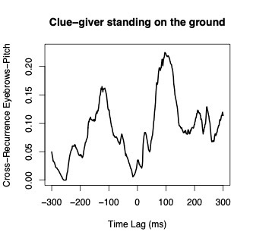
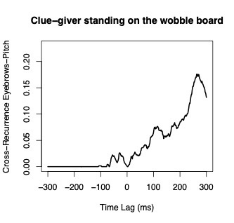
DIAGONAL CROSS-RECURRENCE PROFILE

Slide 12
SUMMARY
Some preliminary evidence (limited) that supports differences between standing on wobble board and standing on ground for how eyebrow movement and pitch are coordinated. Further analysis necessary.

Slide 13
CHALLENGES AND FUTURE DIRECTIONS
Number of datapoints is not the same for all trials in the dataset (and not many datapoints at that)
Head gear - presence of helmet can restrict eyebrow and facial movements
Botulinum Toxin (e.g., Botox) and other muscular argumentation.
Eyebrows in particular susceptible to freezing and reduced movement due as a result of popular aesthetic procedures (Schlager et al., 2019)
Languages play a large role in pitch production, so can expect a cross-linguistic difference in relationship between eyebrow movement and pitch
Extracting accurate eyebrow movement in moving head systems. Accounting for head roll, etc.
Include pitch for guesser
Both interlocutors in unstable settings. same board, different board

Slide 14
REFERENCES
Anikin, A. (2023). The honest sound of physical effort. PeerJ, 11, e14944.
Cavé, C., Guaïtella, I., & Santi, S. (2002). Eyebrow movements and voice variations in dialogue situations: an experimental investigation. In INTERSPEECH (pp. 2353-2356).
Chiu, Y.-F., Longhurst, J. K., Fletcher, A. R., & Loux, T. (2026). Voice changes during dual task walking in Parkinson’s disease. Journal of Communication Disorders, 119, 106615.
Krahmer, E. J., Ruttkay, Z., Swerts, M. G. J., & Wesselink, W. (2002). Pitch, eyebrows and the perception of focus. In B. Bel, & I. Marlien (Eds.), Proceedings of the Speech Prosody 2002, Conference Aix-en-Provence, 11-13 April 20012 (pp. 443-446). Laboratoire Parole et Langage.
Li, M., Yang, J. E., Fuchs, S., & Aussems, S. (2026). Perturbing postural stability affects acoustic properties but not fluency of adult speech production during face-to-face interaction. The Journal of the Acoustical Society of America, 159(6), 5491–5503.
Schlager, S., Kostunov, J., Henn, D., Stark, B. G., & Iblher, N. (2019). A 3D Morphometrical Evaluation of Brow Position After Standardized Botulinum Toxin A Treatment of the Forehead and Glabella. Aesthetic Surgery Journal, 39(5), 553–564.
Tesio, L., & Rota, V. (2019). The Motion of Body Center of Mass During Walking: A Review Oriented to Clinical Applications. Frontiers in Neurology, 10, 999.
Zsiga, E. (2014). Sound recordings: acoustic and articulatory data. In R. J. Podesva & D. Sharma (Eds.), Research Methods in Linguistics (pp. 169–194). chapter 9, Cambridge: Cambridge University Press.

Slide 15
THANK
YOU
our repository (again)

